Slide 1

Session 3.1
Information Gathering – Part 1
Web Application Penetration Testing (WAPT)
Diploma in CSF
Year 2 (2021/22), Semester 2.2

Slide 2
Learning Outcomes
At the end of this session, the learners are expected to be able:
To describe Information Gathering concept
To distinguish between a Scope and Rules of Engagement Document
To make use of the OSINT tools to gather information

Slide 3
Contents
Concept of Information Gathering
Sources of Project
Scope and Rules of Engagement Documents
Tools for Information Gathering
Tools from Open Source Intelligent (OSINT) Framework
Information Gathering Tools in Kali Linux
Information Gathering through use of
Network Resources
Internet/WWW Resources
WebAnalysis Sites

Slide 4
Concept of Information Gathering

Slide 5
Concept of Information Gathering
Also known as Reconnaissance.
The objective is to find out whatever information you or your team needed to accomplish a WAPT project.
Information gathering activity can happen at anytime during a project cycle but needed more often at Pre-Testing phase and Testing phase, depending on how the project was obtained.

Slide 6
Sources of Project

Slide 7
Sources of Project
Public Tender Exercise
Tender document provided by the client would provide most information needed
Pen-testing company needs to review the document, find out whatever information needed, analyze and cost it before putting a bid.
Detailed reconnaissance activities only start in Testing Phase.
Example : https://www.webeltechnology.com/tenderfiles/Final-e-Tender-20-21-009.pdf

Slide 8
Private Invitation – RFP (Request for Proposal)
The Client may just be interested to find a few pen-testing companies to put up proposal for consideration.
In this case, information gathering activity starts in the Pre-Testing phase.
In order to be able to put up a proposal that can be agreeable by the client and generate profits for your company, much accurate information are needed.
Usually a charged professional service to do up a Scope Document and Rules of Engagement Document is appropriate for both parties.
After the above, a good proposal with attractive costing can be achieved.
Example: https://tplinsurance.com/wp-content/uploads/2018/11/TPL-Insurance-Penetration-Testing-RFP-v2.0.pdf

Slide 9
Scope & Rules of Engagement Documents

Slide 10
Scope Document
This document defines what are to be pen-tested and not to be tested and what are to be delivered.
Statements in this document are usually very specific on the web components to be tested.
Example of scope can be found in most tender document or request for proposal document.
Eg., The test will include a load test of 500 concurrent logins.
This document also include information related to the project provided by the client.
Eg., The servers are housed at level 5 server room and only the Chief Engineer has the key to that room.
This document needs to be signed off by representatives from each party and date-stamped.

Slide 11
Rules of Engagement Document
This document defines how the test is to be carry out and all the rules to be followed during a test.
E.g. This will be an unannounced test and all users will not be informed of the pen-test period.
This document also needs to be signed off by representatives from each party and date-stamped.

Slide 12
Benefits of having a Clear Scope & Rules of Engagement Documents
Allow pen-test team to know the level of difficulties of the project and expertise and tools needed.
Estimation of man-hours needed for the project.
Accurate Costing of Project.
Provision for Accommodation, Allowances, Travel expanses
Insurance for Man-Power and Project
Profits for Company
Provision for Project Over-Run
….

Slide 13
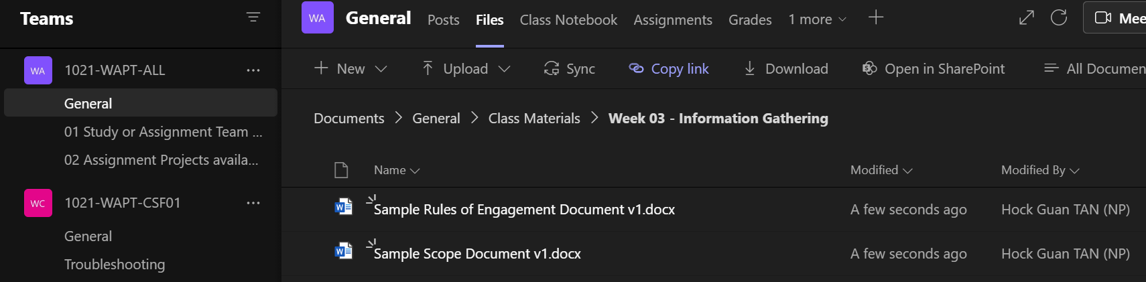
Sample Scope & Rules of Engagement Documents
Sample documents can be found in the following folder in Team:
They are extracted from a team’s report with permission from the client for used as training materials.
Kindly consult your tutor when you writing these document for your assignment.
Note to Tutor - to give students 5 minutes to browse through the documents.

Slide 14
In Practice, during Pre-Testing Phase
In most private pen-test project like in our assignment, the client/owner is not technically inclined and may not be able to provide with the necessary information you needed.
The developer of the client’s project on the other hand is not too willing to provide you with the information for some reasons.
In Public Tender case, the specifications though comprehensive but may missed certain information that you needed.

Slide 15
The tenderer/bidder needs to make best use with whatever information at hand to win the project.
After wining the project, the project team will have to review all the relevant project documents, to see if there are further information needed to plan, execute and accomplish the project.

Slide 16
Tools for Information Gathering

Slide 17
Tools from Open Source Intelligent (OSINT) Framework
For information gathering, there are wide variety of OSINT tools to choose from and most of these are included under the OSINT Framework.
What information to collect depends on the project. The information collected must be purposeful and meaningful to the project.
No fix rules on which tool to use and what to mine first. However, the depth of information required might need to be determined.
11/3/2021
1020-WAPT-Session 2.2-Passive Reconnaissance
17

Slide 18
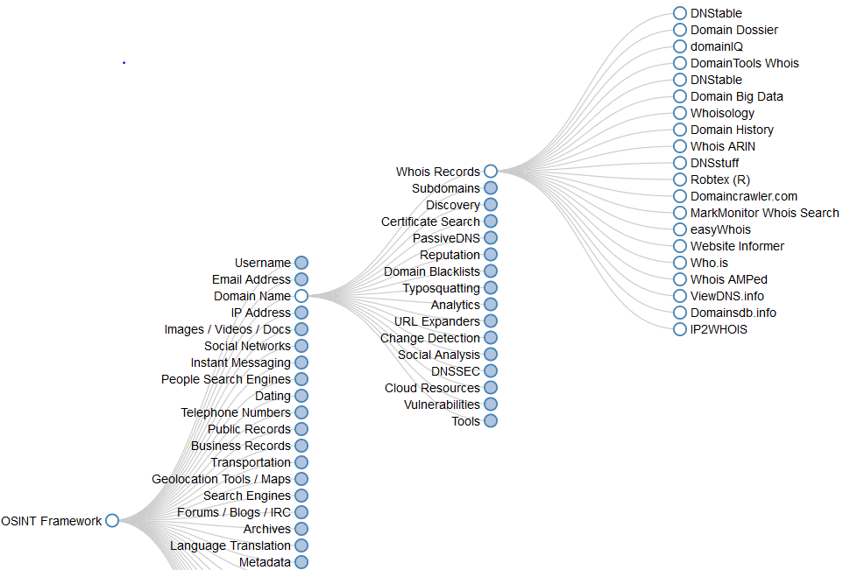
In the framework, the tools are being categorize and sub-categorized in accordance to their different purposes and nature.
11/3/2021
1020-WAPT-Session 2.2-Reconnaissance
18

Slide 19
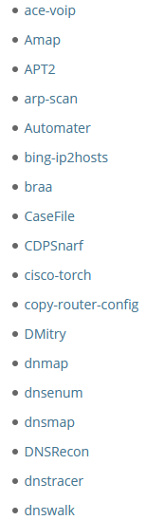
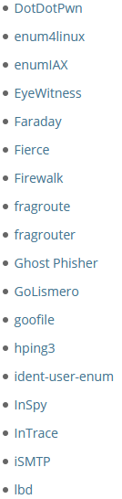
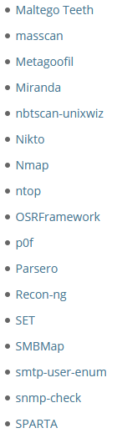
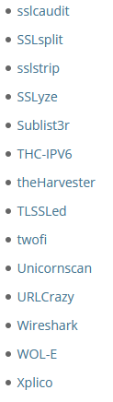
Information Gathering Tools in Kali Linux
https://tools.kali.org/tools-listing
We will use a number of these in WAPT.

Slide 20
For the purpose of this module, we explore tools for Information Gathering :
Through Network Resource
whois, nslookup, host, dnsrecon, dnsenum
Through the Internet/WWW
subbrute, Google Search Operators, Google Dorking Database, shodan, nse, theHavester, Maltago
Through Web Analysis
Website-Watcher, Pingdon, WayBackMachine

Slide 21
Information Gathering through Network Resource

Slide 22
Information Gathering through Network Resource
A lot of information can be mined from the open network resources in the public space.
These resources in the public domain include the following:
Domain Name Registration Record in the Registry of the Registrar.
Records in the Domain Name Server
11/3/2021
1020-WAPT-Session 2.2- Passive Reconnaissance
22

Slide 23
The Internet Registrar and Registry
Each website can be reached via a public IP Address. But convenient and easy reference by end-users, the owner (Registrant) normally register an Internet domain name with an Internet Registrar.
The Registrar's Registry (Database) would contain all the contact information associated with the person, company, or other entity that registered the domain name, and all other network related information.
Anyone can query the Registry using the "whois" utility. When you do, one of the registries will handle your request and send you details of the Domain Name or associated IP Address(es).

Slide 24
Activity 3.1.1 – Hands-On
In this activity, we will explore the "whois" command to gather information on targeted web sites.
Important Notice
Poly blocks some of the communication protocols and you may need to use the hotspot on your hand-phone while do this activity in school.
Instruction
Start Kali Linux VM and change network setting to NAT
Start a Terminal and Follow the instructions on the following slides.
No submission needed.
11/3/2021
11/3/2021
1020-WAPT-Session 2.1-Passive Reconnaissance Basic
24
24

Slide 25
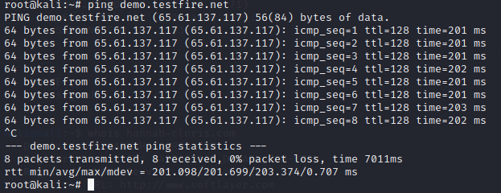
To obtain the IP Address associated with a domain name ...
We use "ping" command in Kali Linux.
Open up a terminal and try the command line as shown.
The IP address is resolved by the DNS server and that means the website can be reached by using the IP address.
03/11/2021
11/3/2021
11/3/2021
1020-WAPT-Session 2.1-Passive Reconnaissance Basic
25
25
25

Slide 26
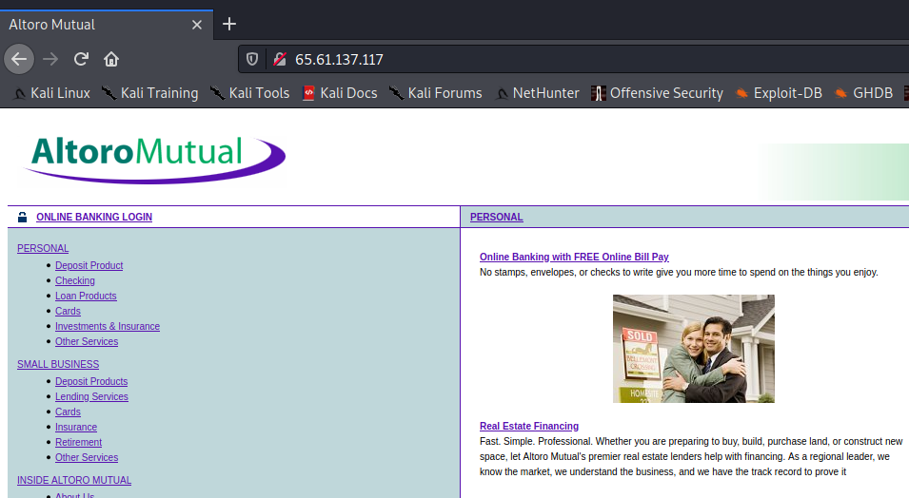
Open up the browser in Kali Linux and type the IP address into the URL.. You will see the web page as well.

Slide 27
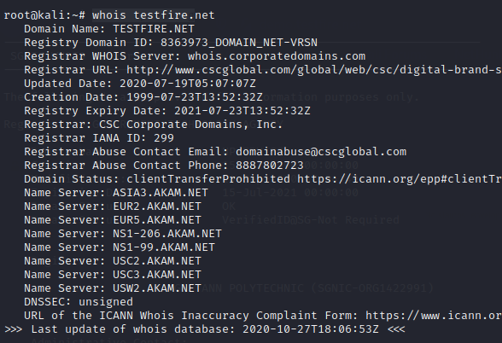
To find the owner of the domain name ...
We use the "whois" command in Kali Linux
Scroll down the page od info, are the Registrant info. Available?

Slide 28
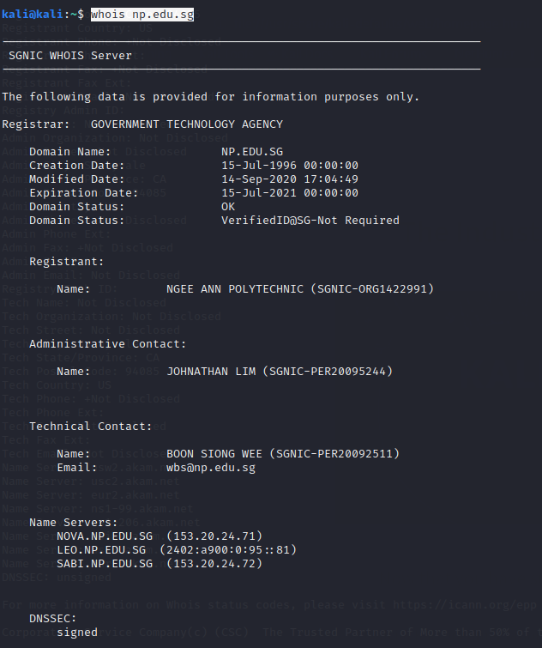
Use the same command and try the domain name np.edu.sg.
Are the Registrant info. available?
Which site is secure?

Slide 29
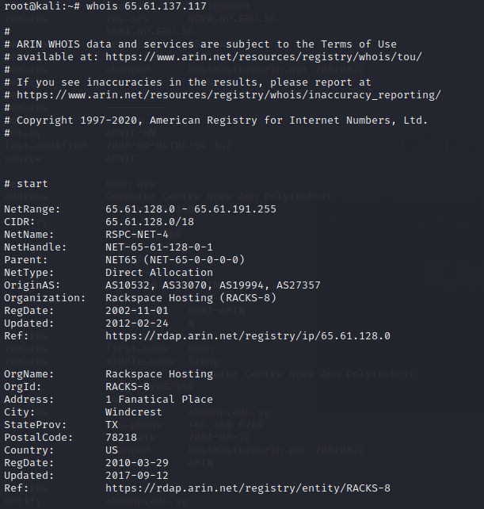
Now let's try something different...
Now try whois 65.61.137.117
The Registry sever return a range of IP address that has been assigned to the Registrant, in this case a Hosting Service company.

Slide 30
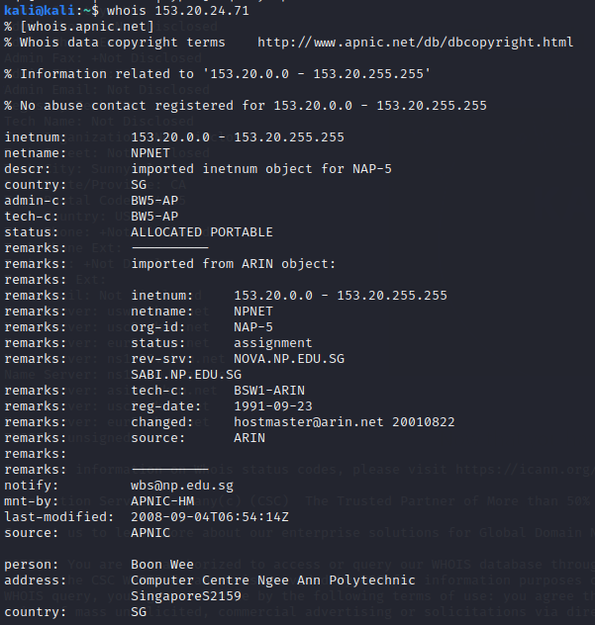
Now try the IP address of a name server of our polytechnic. The name server is the Domain Name Server (DNS). A range of IP address is returned as well. What are they?

Slide 31
Observations
The information gathered are from Registry database resided with the Registrar. They are published information and the activity did not send any packets to the website server; thus this is a passive reconnaissance activity.
In Singapore, the Registrars (resellers) are controlled by SINGNIC (main Registrar for SG, i.e. Domain names ended with .sg).

Slide 32
Each organization is assigned with an IP Address Block
These IP Address Block obtainable from Regional Internet Registries (RIRs)’s Whois databases.
ARIN(American Registry for Internet Numbers)
US, Canada, Certain Caribbean Island
RIPE NSS (Research IP Europeans Network Coordination Centre)
Europe, Middle East, part of Central Asia
APNIC (Asia-Pacific Network Information Centre)
Asia-Pacific region
LACNIC (Latin American and Caribbean Internet Address Registry)
Latin American, most part of Caribbean
AfriNIC (Africa Network Information Centre)
African Continent

Slide 33
Gather information from Domain Name Server (DNS)
DNS Server translates the Domain Name to IP Address and Vice Versa.
There are usually more than one DNS Server in an organization.
There may be time you need to check for the Domain Name Servers/Name Server in the organization.
We will look at how to hunt down the domain name servers within an organization.

Slide 34
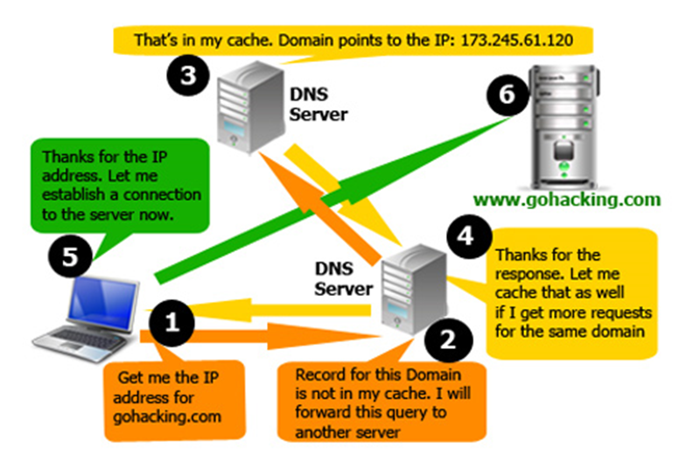
How DNS Works (Recap)

Slide 35
Activity 3.1.2 - Hands-on
In this lab activity, we will explore the "nslookup" and "host" command to gather information on the target web site.
Important Notice
Poly blocks some of the communication protocols and you may need to use the hotspot on your hand-phone while do this activity in school.
Instruction
Start Kali Linux VM and change network setting to NAT
Start a Terminal and Follow the instructions on the following slides.
No submission needed.
11/3/2021
11/3/2021
35
35

Slide 36
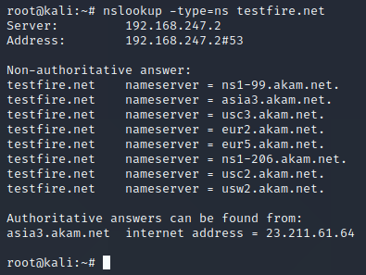
Use of "nslookup" command
Used to interact with a DNS server to get information on name servers.
Syntax: nslookup –type=ns domain_name
ns – name server/dns server
Source https://www.computerhope.com/unix/unslooku.htm

Slide 37
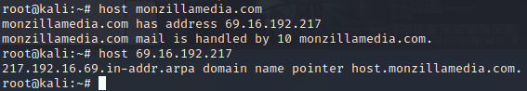
Use of "host" command
Allow pen-tester to do reverse DNS Lookup
Syntax: host <IP Address>
Source: https://www.thegeekstuff.com/2012/07/nslookup-examples/

Slide 38
Observations
The Domain Name Server must do that job of Domain Name translation. These DNS records are published information and readily available to the host requesting it, the tools used does not affect the web site. This is a passive reconnaissance activity.

Slide 39
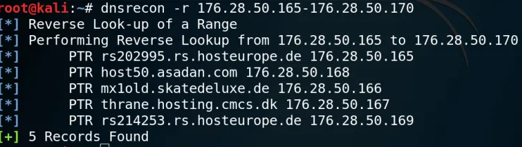
Other Good Tools for Mining DNS Domain Name or IP Address
“dnsrecon” – reverse searches for domain name give a range of IP address.
dnsenum - Locating all DNS servers and DNS entries for an organization.

Slide 40
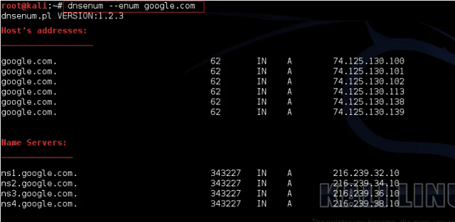
dnsenum - Locating all DNS servers and DNS entries for an organization.

Slide 41
Information Gathering through WWW/Internet

Slide 42
Information Gathering through WWW/Internet
There are a lot more information can be gathered for the WWW pages or free data site from the Internet.
In this section, we look at OSINT tools that allows us to gather intelligence through the World-Wide-Web or the Internet.
11/3/2021
1020-WAPT-Session 2.2- Passive Reconnaissance
42

Slide 43
Activity 3.1.3 – Hands-on
In this activity, we will explore the “subbrute” command to gather information all the sub-domains within a domain.
Important Notice
Poly blocks some of the communication protocols and you may need to use the hotspot on your hand-phone while do this activity in school.
Instruction
Start Kali Linux VM and change network setting to NAT
Start a Terminal and Follow the instructions on the following slides.
No submission needed.
11/3/2021
11/3/2021
1020-WAPT-Session 2.1-Passive Reconnaissance Basic
43
43

Slide 44
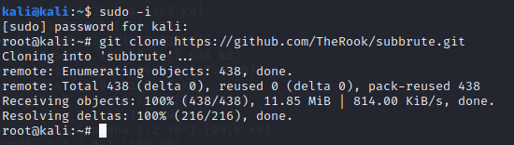
This is a tool written in Python and you need to clone it from GitHub.
In your Kali Linux VM, start a terminal and sudo to root user.
Copy the following : #git clone https://github.com/TheRook/subbrute.git
and run it in your terminal.

Slide 45
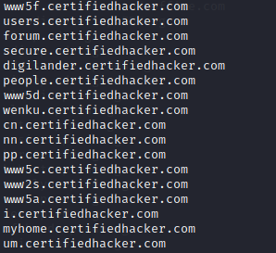

Slide 46
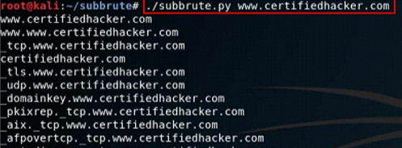
Use of “subbrute” command
to find out from the Internet the sub-domain names that the organization uses

Slide 47
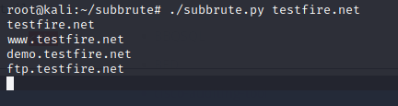
In the results, you will find the sub-domain within the testfire.net website. There are information gathered from web pages.

Slide 48
Observations
This is another passive reconnaissance approach to gather info. on sub-domain names from pages already published.

Slide 49
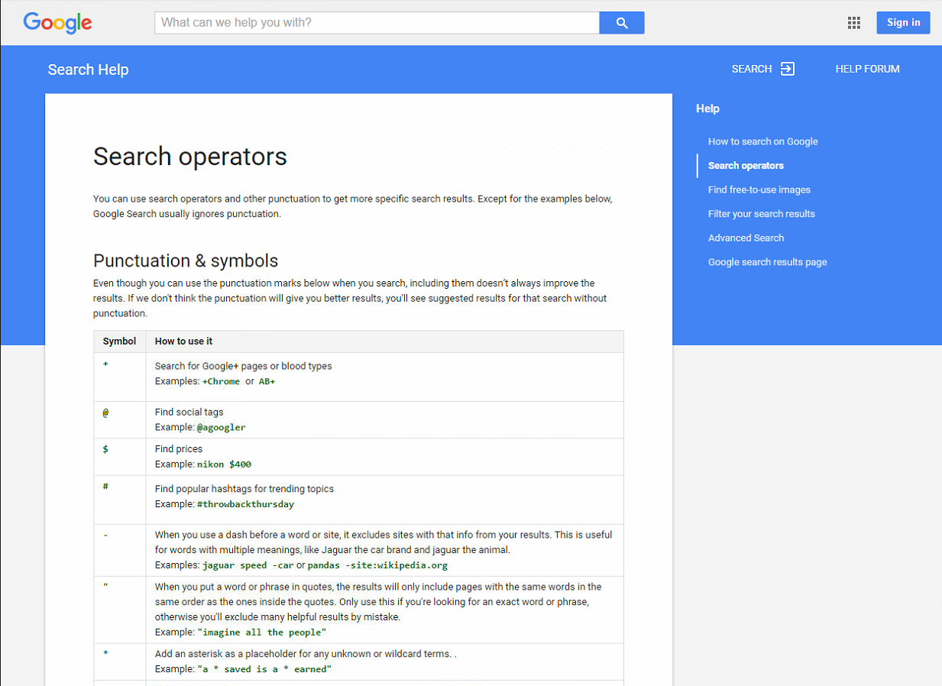
Use of Google Search Operators

Slide 50
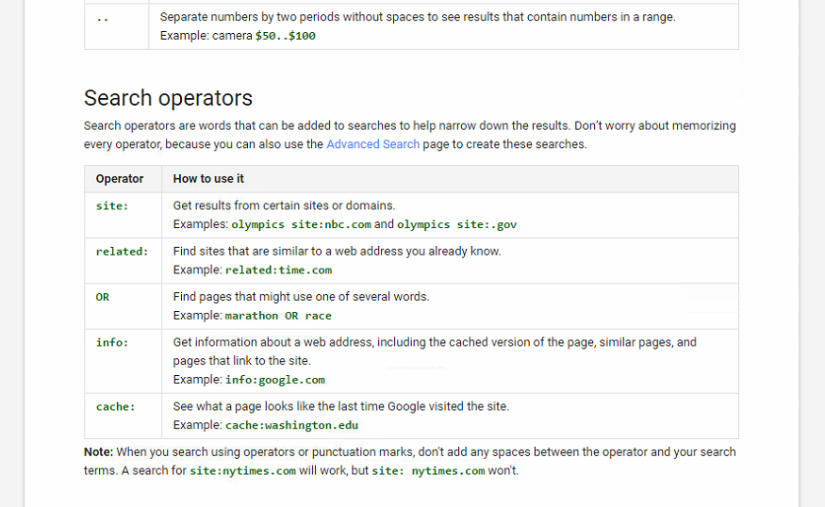

Slide 51
Activity 3.1.4 - Hands-on
In this activity, we will explore the use google operator to search for information or data.
Important Notice
Poly blocks some of the communication protocols and you may need to use the hotspot on your hand-phone while do this activity in school.
Instruction
Start Kali Linux VM and change network setting to NAT
Start a Terminal and Follow the instructions on the following slides.
No submission needed.
11/3/2021
11/3/2021
1020-WAPT-Session 2.1-Passive Reconnaissance Basic
51
51

Slide 52
Try these out by following the examples given:
Sample Operator | Description | Example (enter into your browser URL) and examine the results
link: | Shows all sites linked to a given site | link: www.pmo.gov.sg link: www.np.edu.sg
intitle: | Shows pages whose title matches the search criteria | intitle: www.np.edu.sg password
inurl: | Shows similar pages whose URL matches the search criteria | inurl: login.php
site | Limit search to given URL | site: np.edu.sg
intext/inbody | Search for the key word in the pages | Intext: password
http://www.googleguide.com/advanced_operators_reference.html

Slide 53
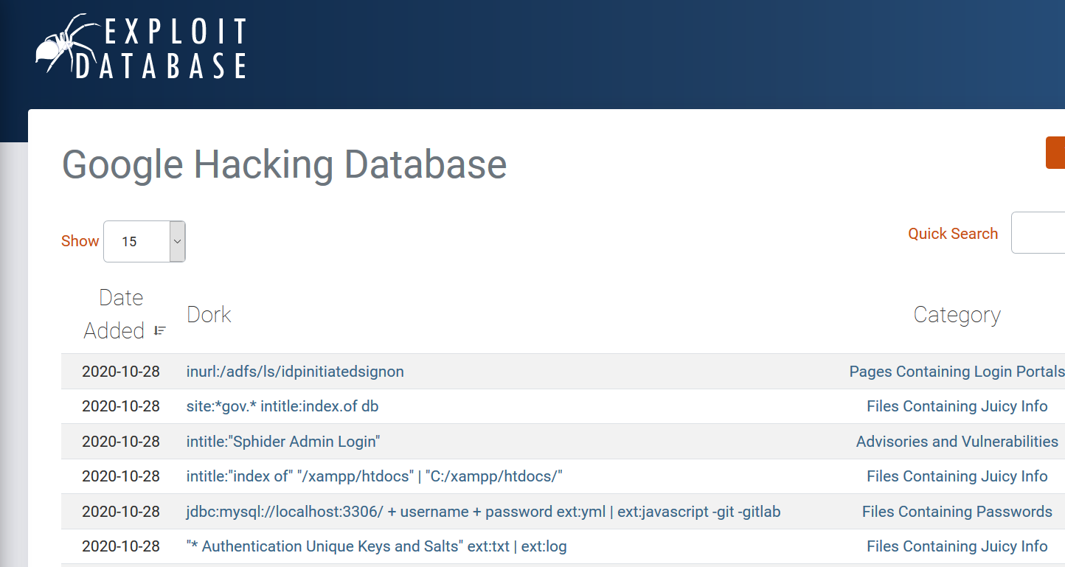
Not familiar or need time to learn the Operators?
Take a look at Google Hacking Database
https://www.exploit-db.com/google-hacking-database

Slide 54
Observations
The above tools helped to gather information from published or archived web pages and data. The tools used does not affect the web site. They are passive reconnaissance activities.

Slide 55
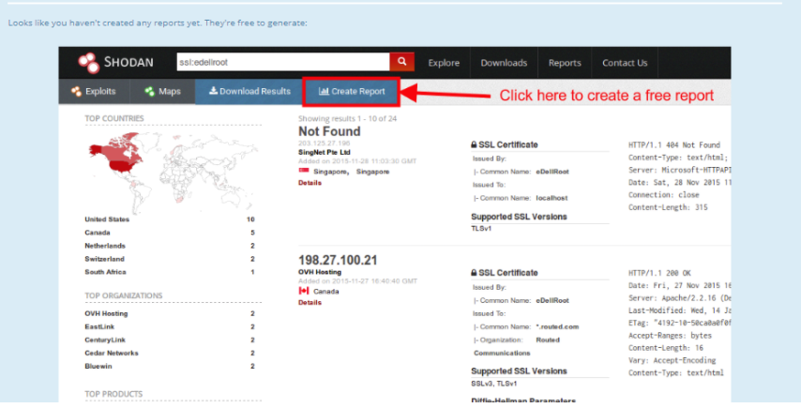
Other Good Tools for Mining Info and Data from WWW/Internet
“shodan - find devices in the public space

Slide 56
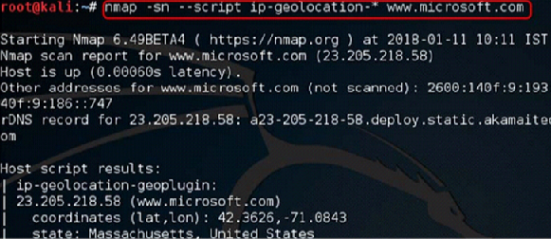
NSE - nmap scripting engineering to find geographical location of the target device.

Slide 57
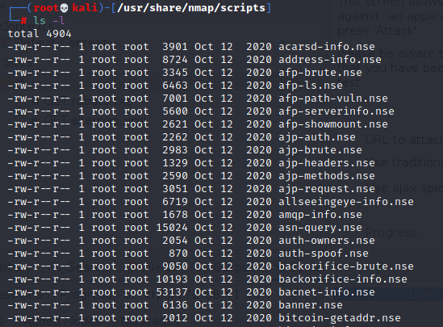
Extra Update Added
Path to all the latest NSE scripts in Kali Linux

Slide 58
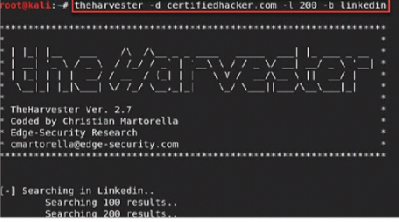
thehaverster - to harvest email addresses to use for social engineering purpose

Slide 59
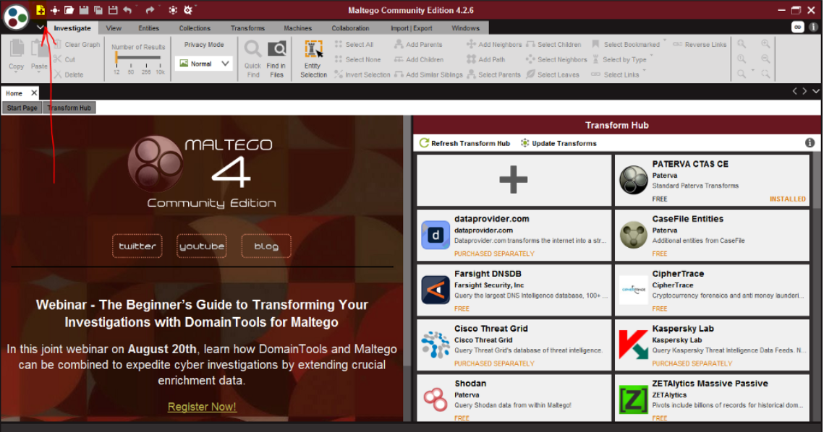
Maltego - OSINT with graphical link analysis tool
Able to gather and connect information for investigation purpose.

Slide 60
Activity 3.1.5 - Exploration (Updated)
Work with your peers in your Study Team/Assignment Team.
Each member choose one from the following tool and try it out and teach one another.
Shodan
NSE to find geographical location (PLUS 4 OTHER INTERESTING SCRIPTS)
Thehaverster
Maltego
Create a Folder with your Team Name in Week 3 Channel.
Record the steps in a PowerPoint file and Name your file as follows: A315-Your First Name.pptx.
Submit to your team’s folder.

Slide 61
Information Gathering through Web Analysis

Slide 62
Information Gathering through Web Analysis
In this section, we look at Tools that allows us to gather intelligence through Web Analysis.
11/3/2021
1020-WAPT-Session 2.2- Passive Reconnaissance
61

Slide 63
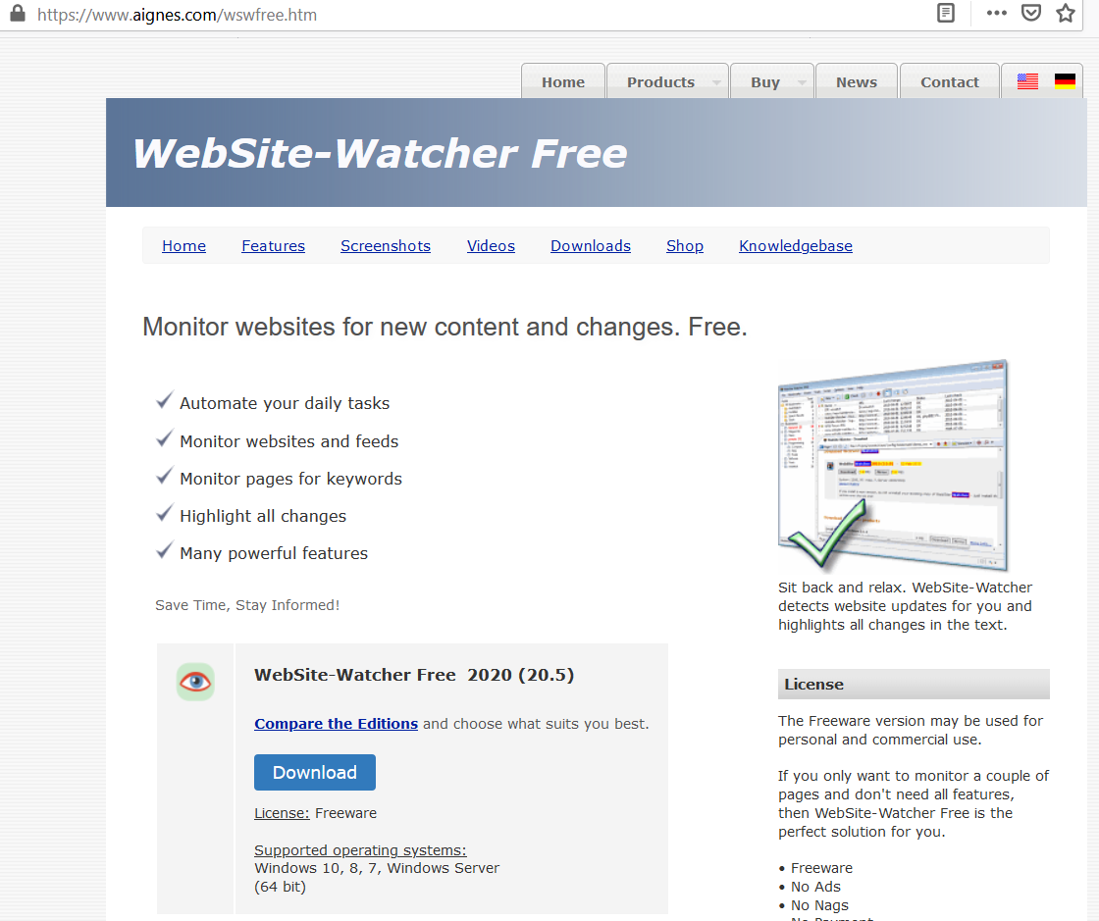
Use of WebSite-Watcher - Are you looking at old posting ?

Slide 64
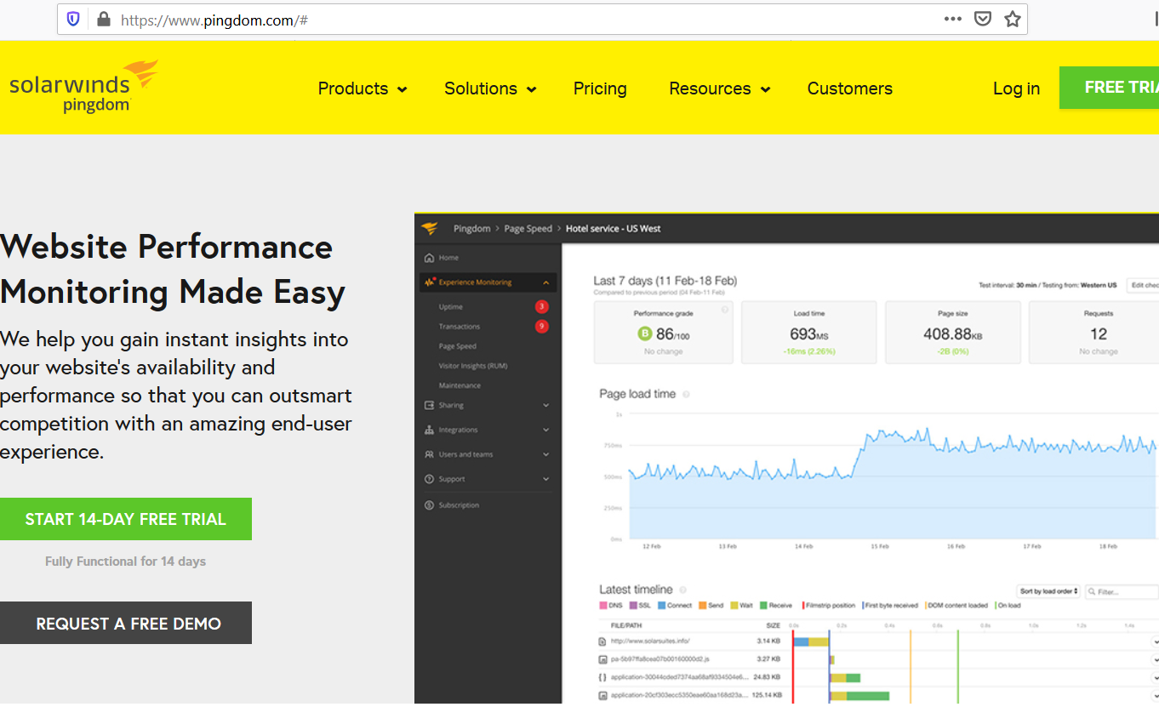
Use of pingdom – Look for attack information

Slide 65
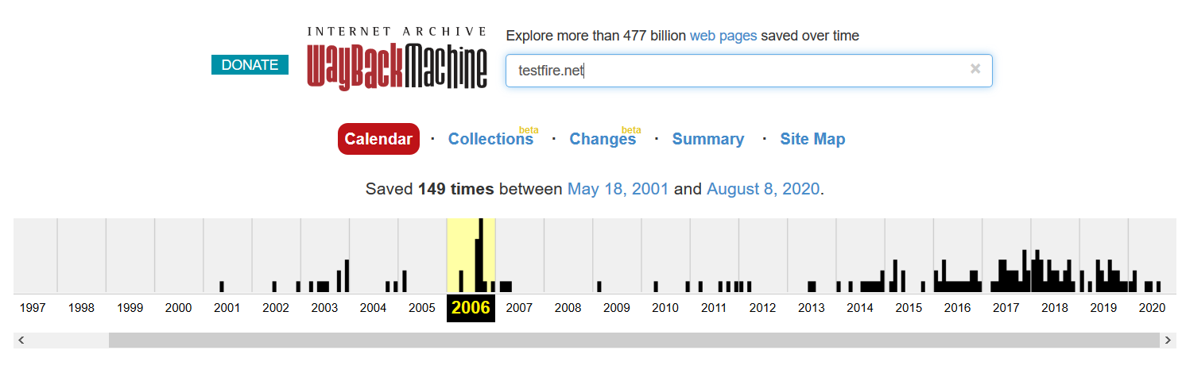
Use of WayBackMachine – Why the change?
https://web.archive.org/

Slide 66
Summary
We have gone through the following:
Concept of Information Gathering
Sources of Project
Scope and Rules of Engagement Documents
Tools for Information Gathering
Tools from Open Source Intelligent (OSINT) Framework
Information Gathering Tools in Kali Linux
Information Gathering through use of
Network Resources
Internet/WWW Resources
WebAnalysis Sites

Slide 67
End of Session 3.1

Slide 68
What’s next?
Information Gathering – Part 2

